Slide 1
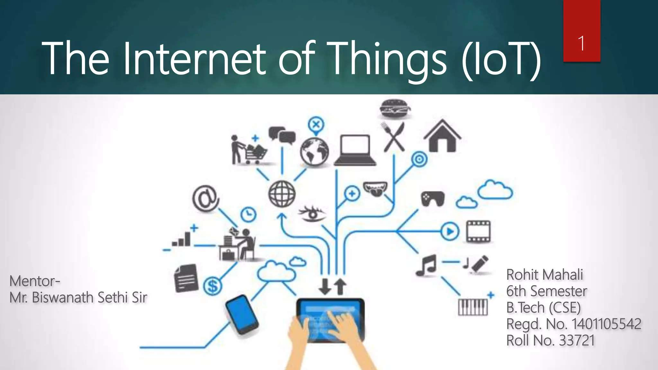
Part 1: Introduction to IOT
By Dr. Masyitah Abu

Slide 2
What is IoT?
Internet of Things (IoT) is a system of devices connected to the Internet with the ability to collect and exchange data from users or environment with no human intervention.
The device or the ‘thing’ in IoT could be any device embedded with electronics, software and sensor like a smart refrigerator, a smart air conditioner, lights in household, connected security systems or even a person with a heart monitor or an automobile.

Slide 3
Why IoT?
We want to automate everything
We want to control everything remotely
We want to see data in real-time

Slide 4
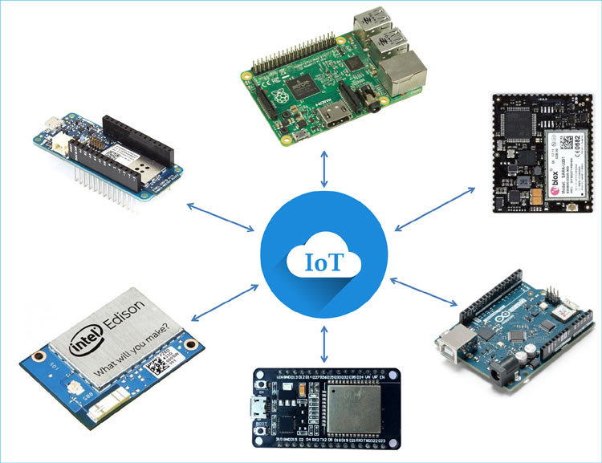
About IoT (Sensor)
Sensors are fitted everywhere across every devices collecting real-time data consistently.
Every device has its unique id which makes the communication possible among them.

Slide 5
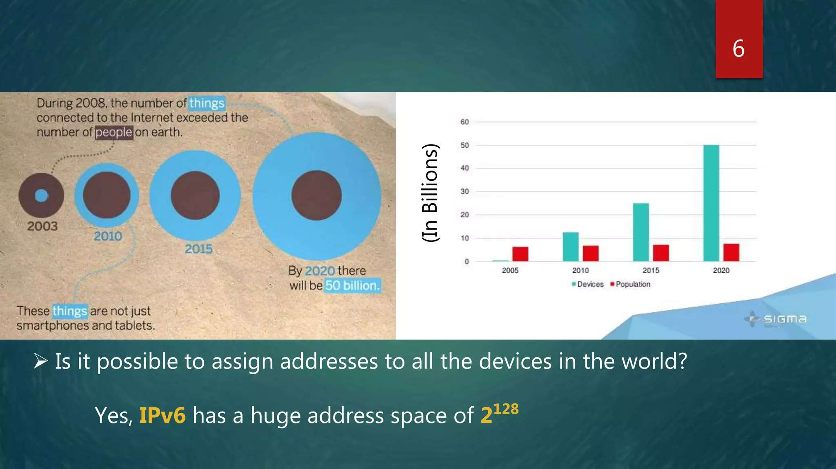
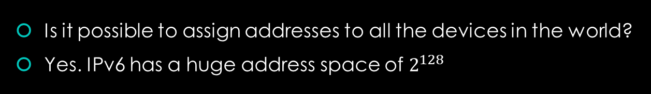
About IoT (Communication)
Is it possible to assign addresses to all the devices in the world?
Yes. IPv6 has a huge address space of $2^{128}$

Slide 6
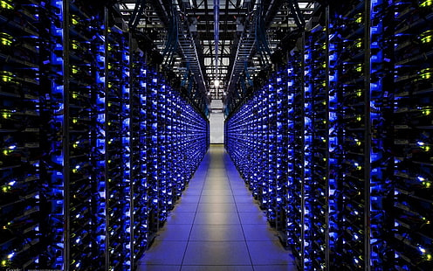
About IoT (Storage)
Tons of data are collected from devices all over the world.
Where could we store this huge sum of data?
The answer is “Cloud”

Slide 7
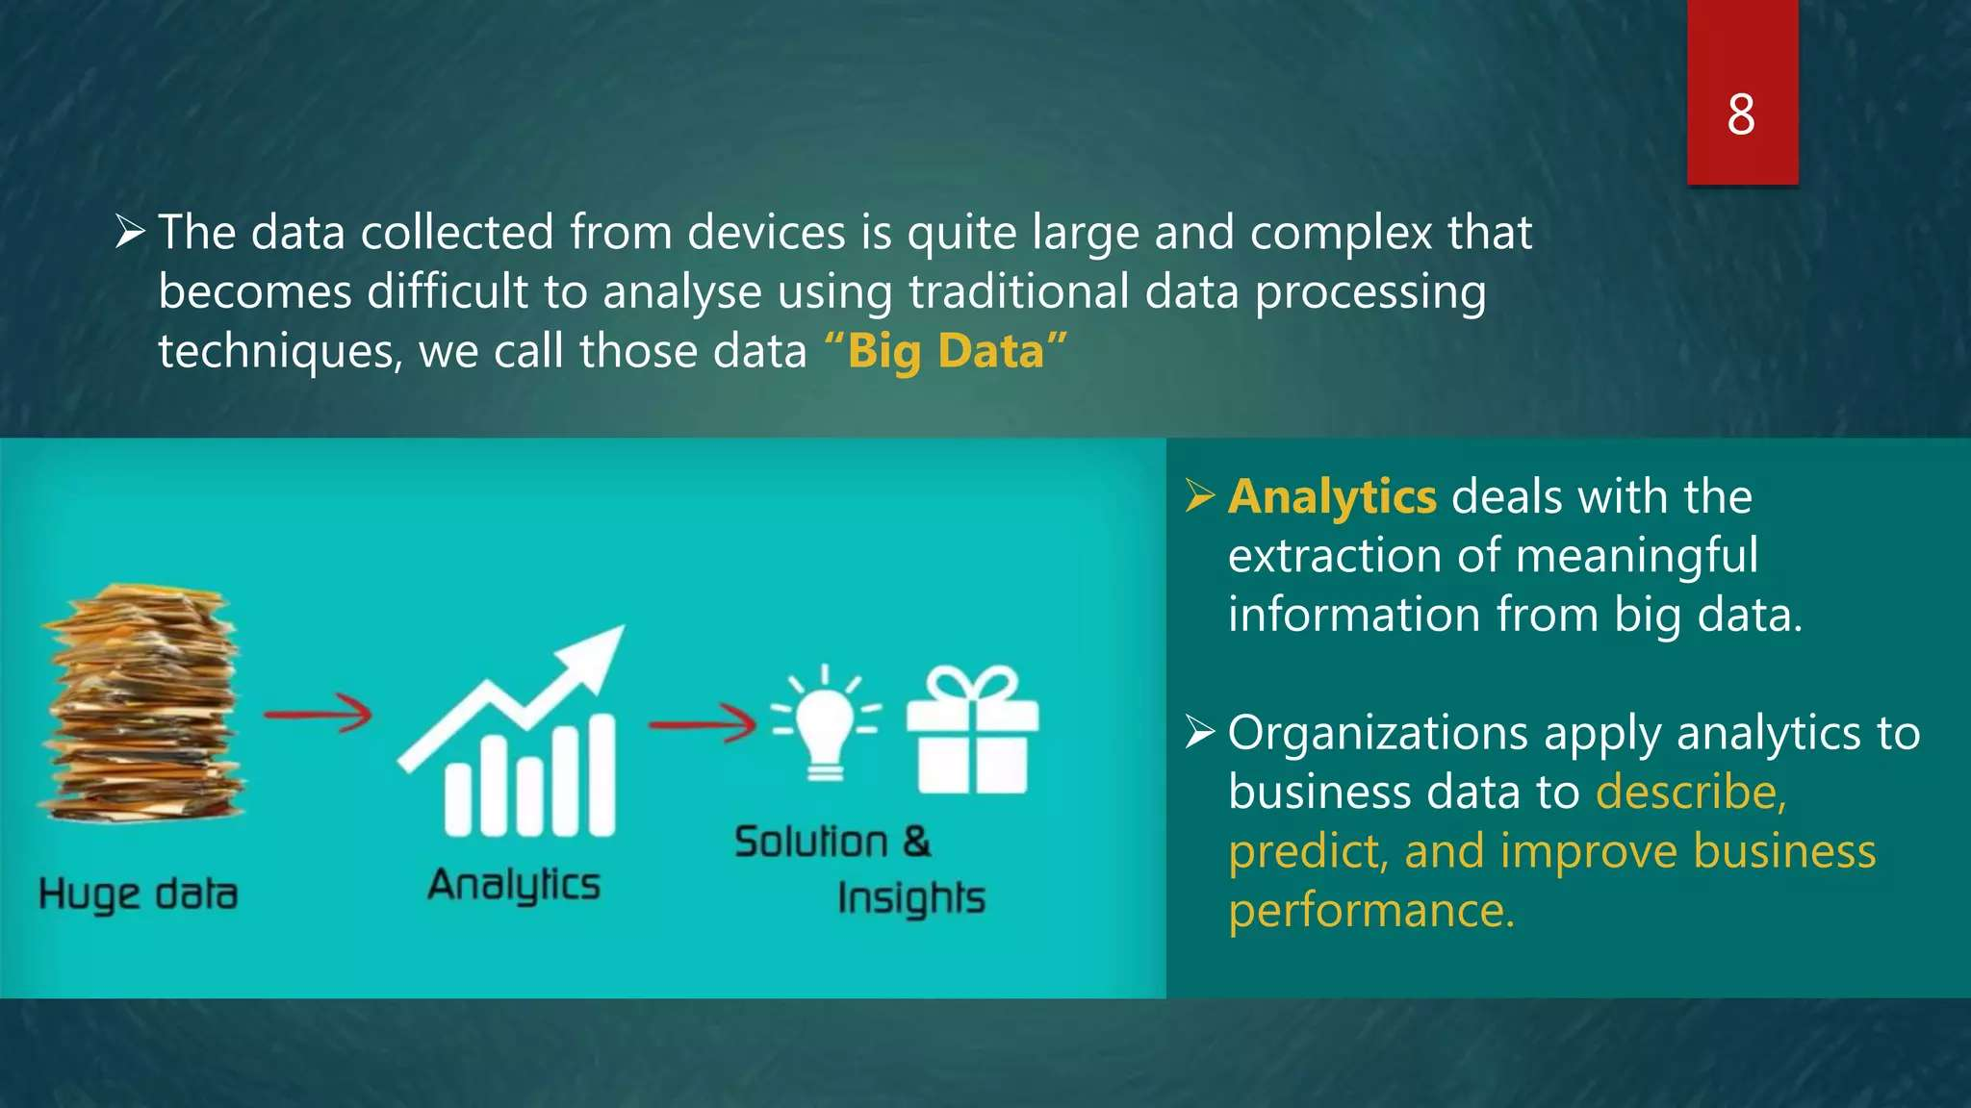
About IoT (Analytics)
The data collected from devices is quite large and complex that becomes difficult to analyze using traditional data processing techniques, we call those data “Big Data”

Slide 8
History of IoT
The term “Internet of Things” is coined by Kevin Ashton in 1999
Early example, 1982, Coke machine at Carnegie Mellon University was connected to internet which reported its inventory and temperature.

Slide 9
Applications of IoT
- Smart Homes: Automated lighting, security systems
- Healthcare: Wearable health monitors
- Agriculture: Smart irrigation systems
- Industry: Predictive maintenance and automation

Slide 10
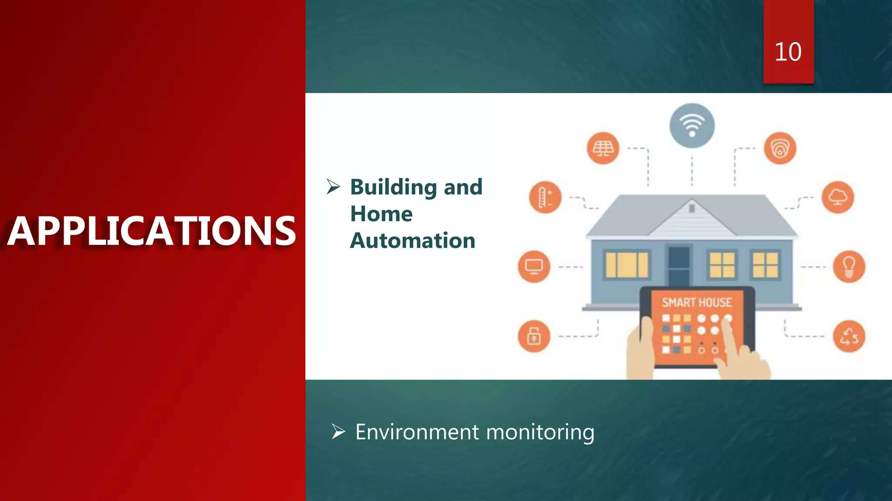
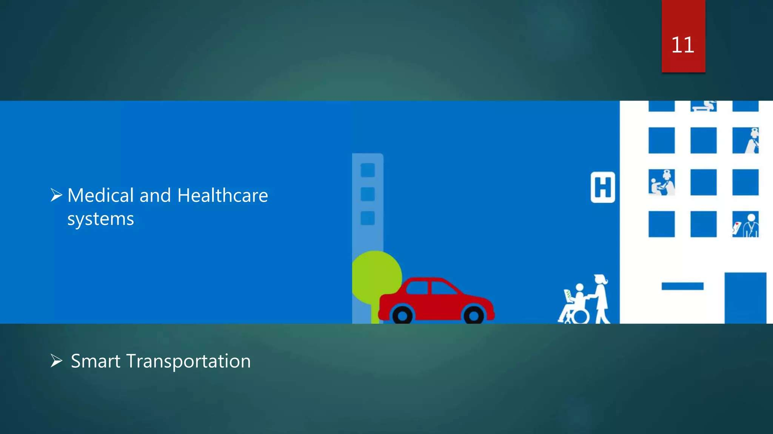
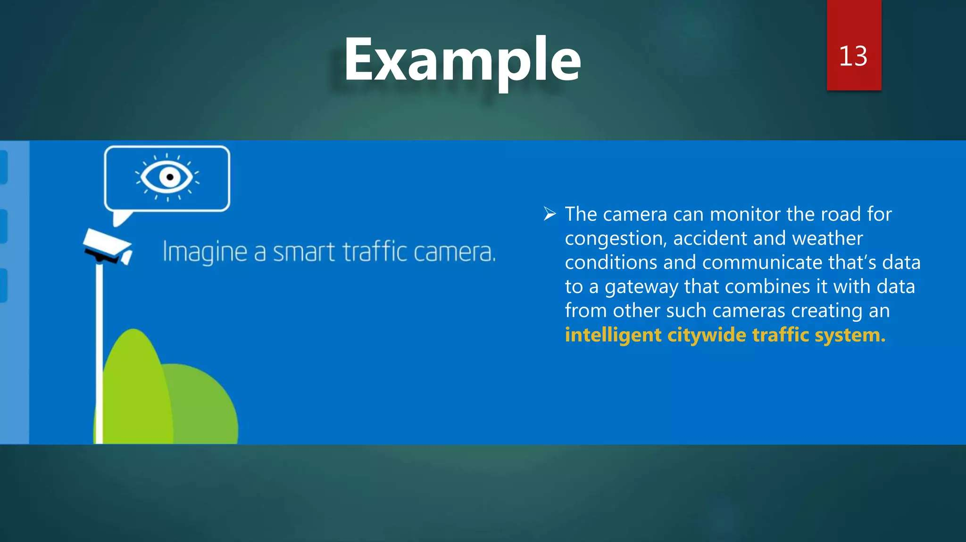
Example

Slide 11
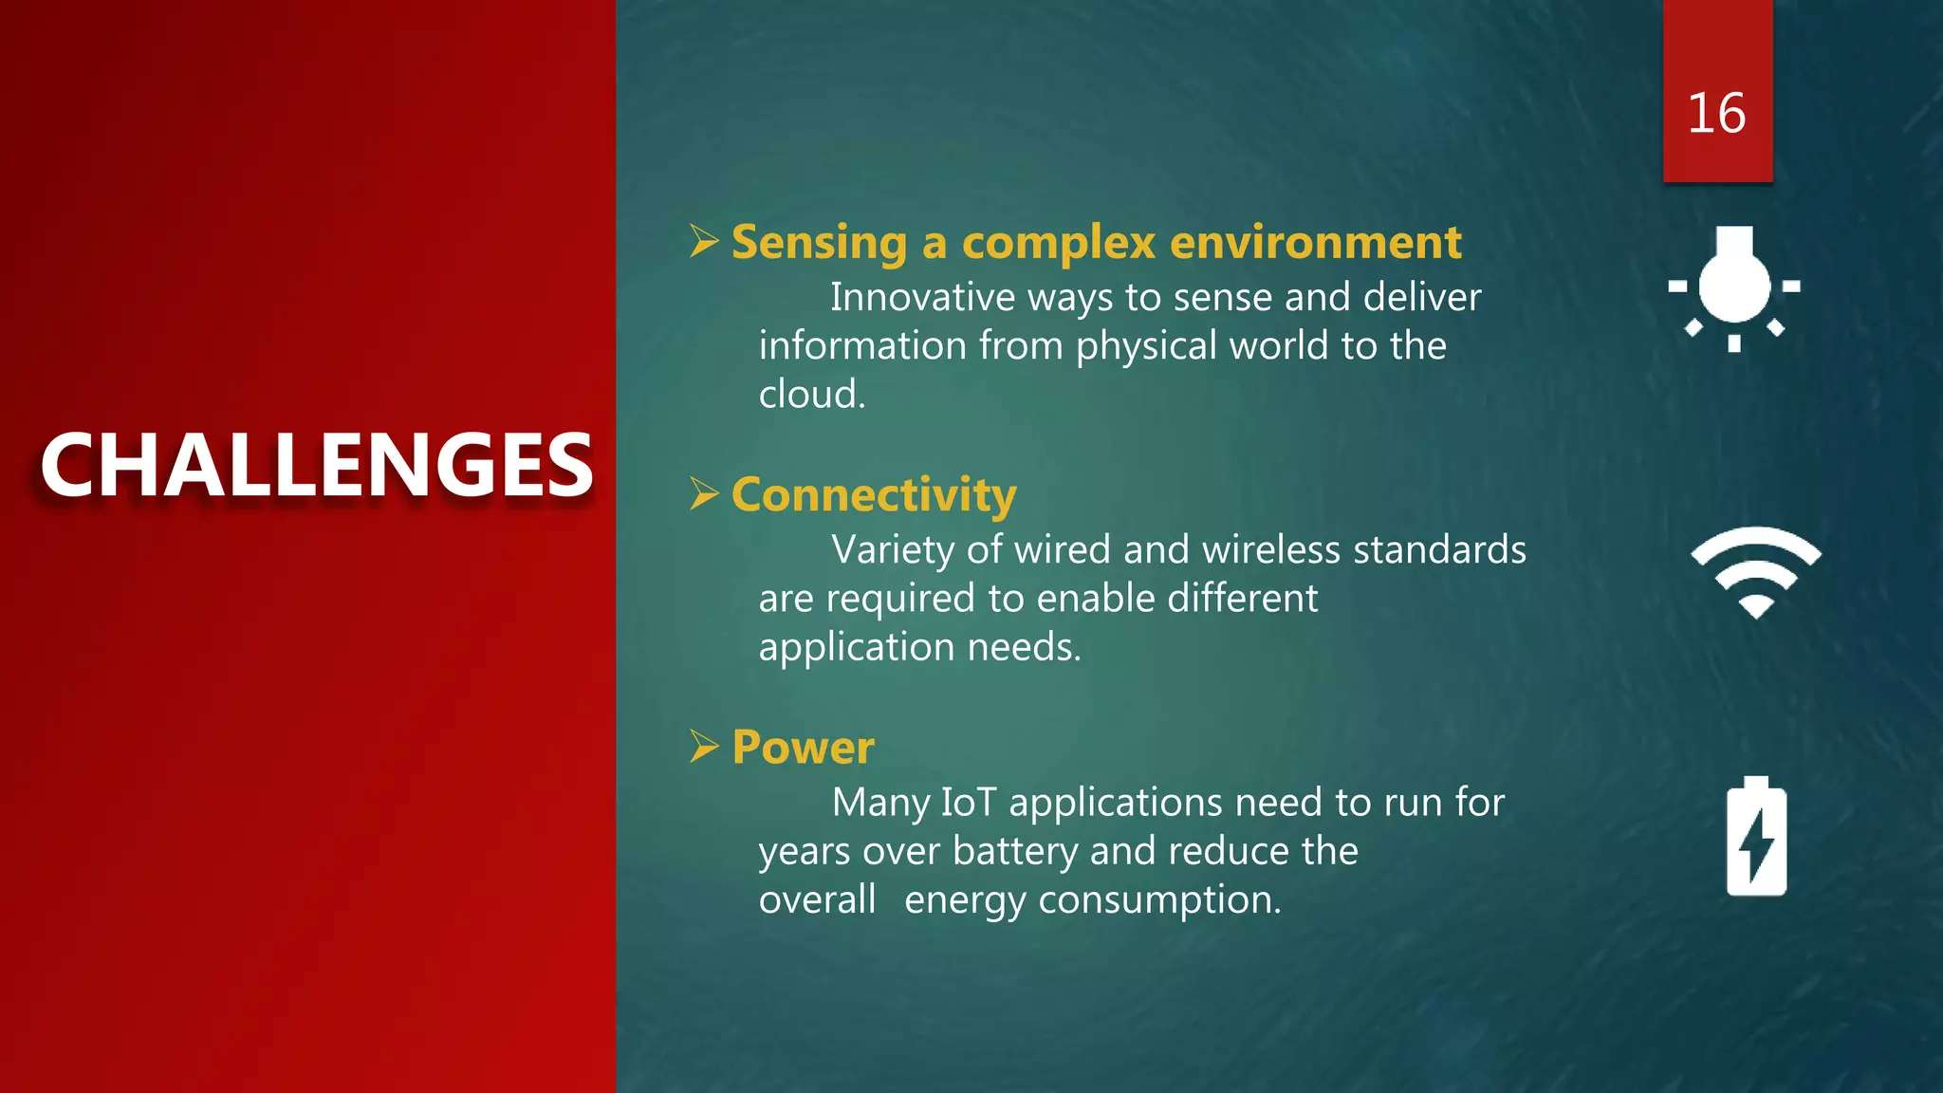
Challenges
Sensing a complex environment
Connectivity
Power
Innovative ways to sense and deliver information from physical world to the cloud
Variety of wired and wireless standards are required to enable different application needs
Many IoT applications need to run for years over battery and reduce the overall energy consumption

Slide 12

30 minutes rest

Slide 13
Part 2: About Proteus and it’s basic tools
By Dr. Masyitah Abu

Slide 14
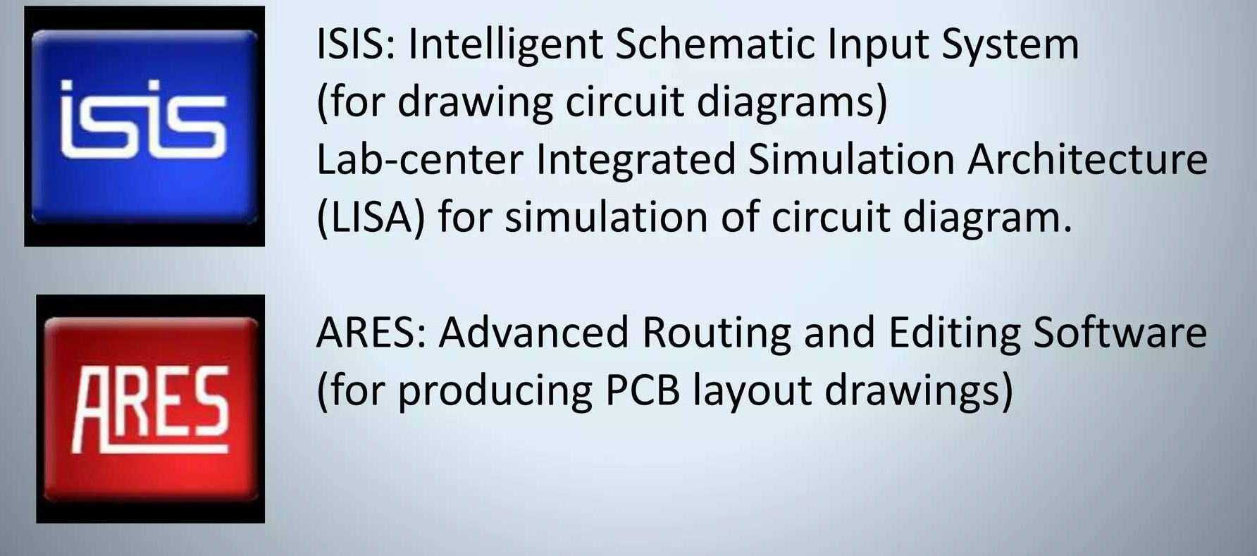
Proteus
Proteus is product of Lab-center Electronics Ltd http://www.labcenter.com/

Slide 15
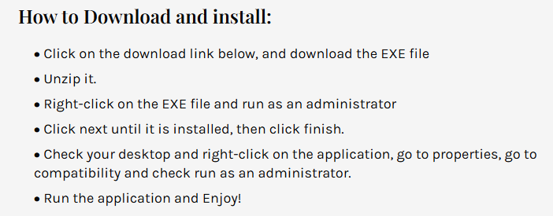
How to install Protues

Slide 16
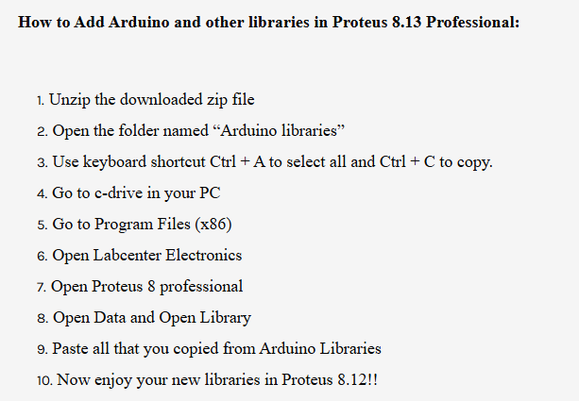
Add libraries

Slide 17
Installation Link
Install Proteus 8.13 2021: https://www.afronicsblog.com/2021/11/how-to-download-and-install-proteus-813.html#google_vignette
Install other driver: https://www.afronicsblog.com/2021/11/how-to-add-new-libraries-into-proteus.html?m=1
Arduino Ide: https://www.arduino.cc/en/software

Slide 18

Setup Proteus in your workspace

Slide 19
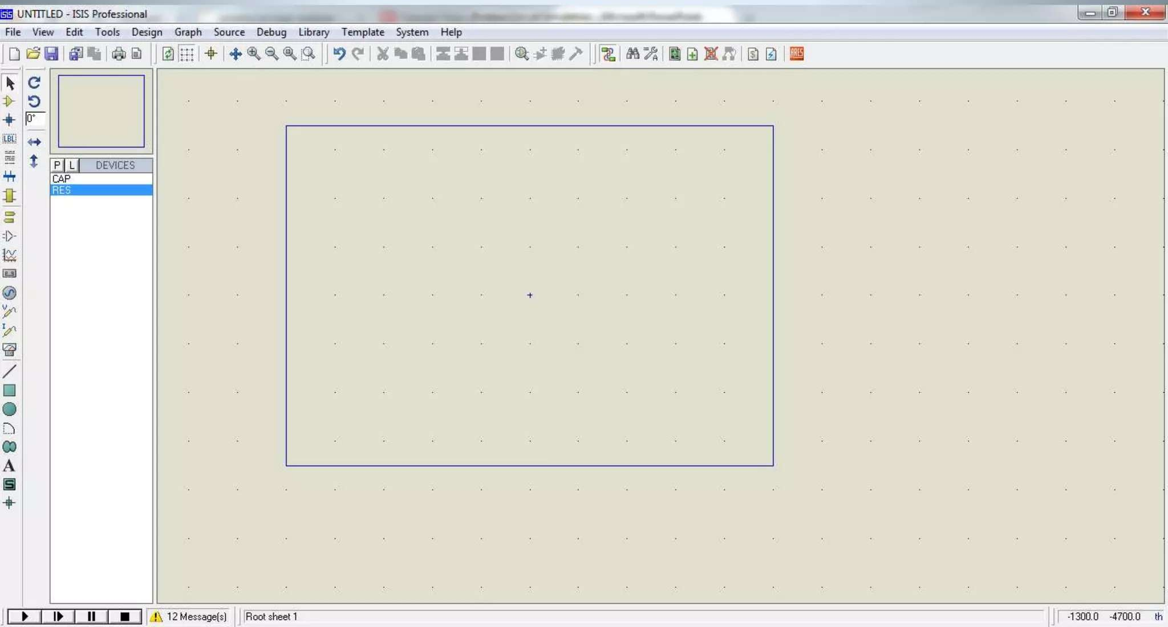
Proteus ISIS IDE Environment

Slide 20
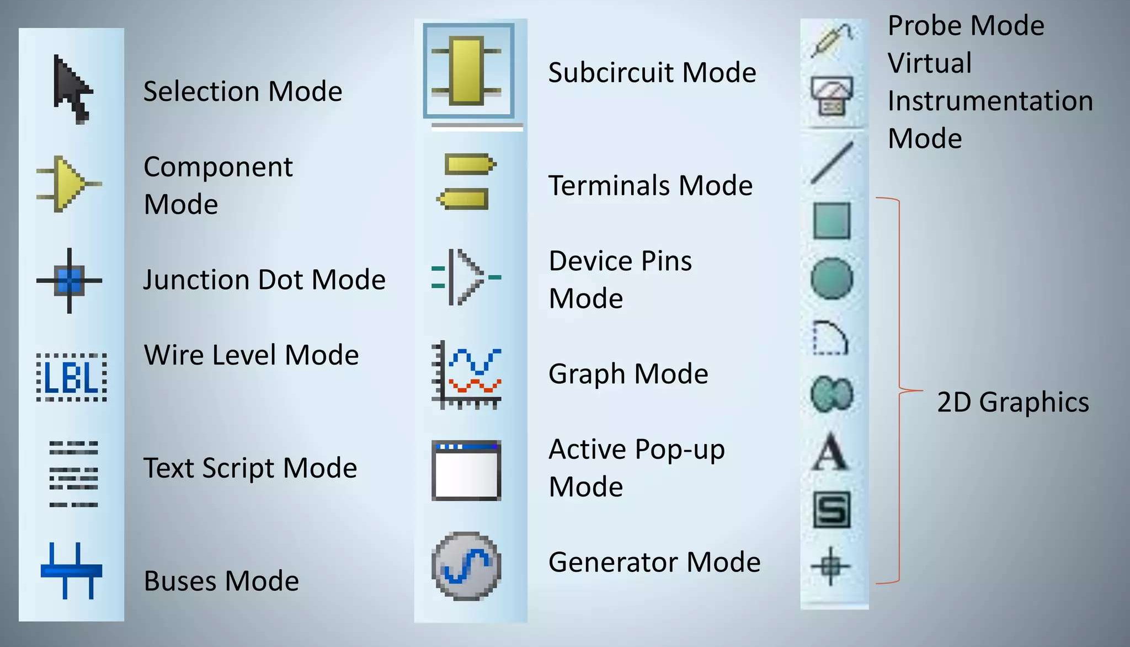
Proteus ISIS Mode

Slide 21
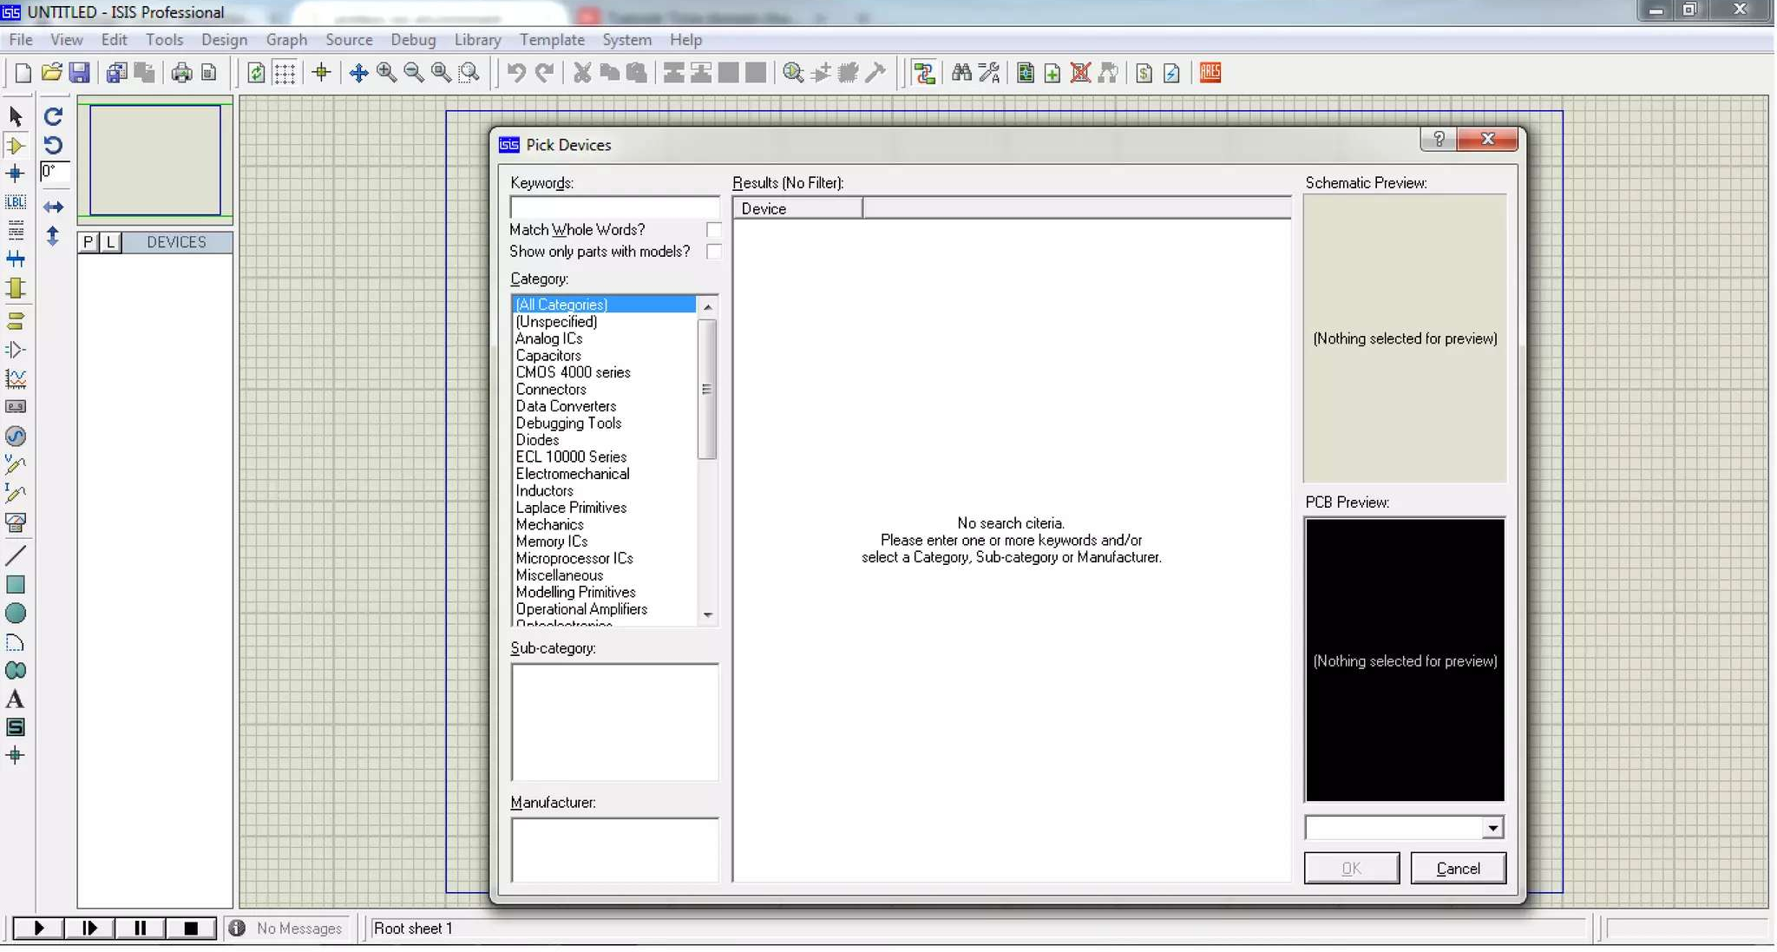
Component Mode
To select Component select Component Mode then click on icon “P” for place component (or simply press key ‘P’)

Slide 22
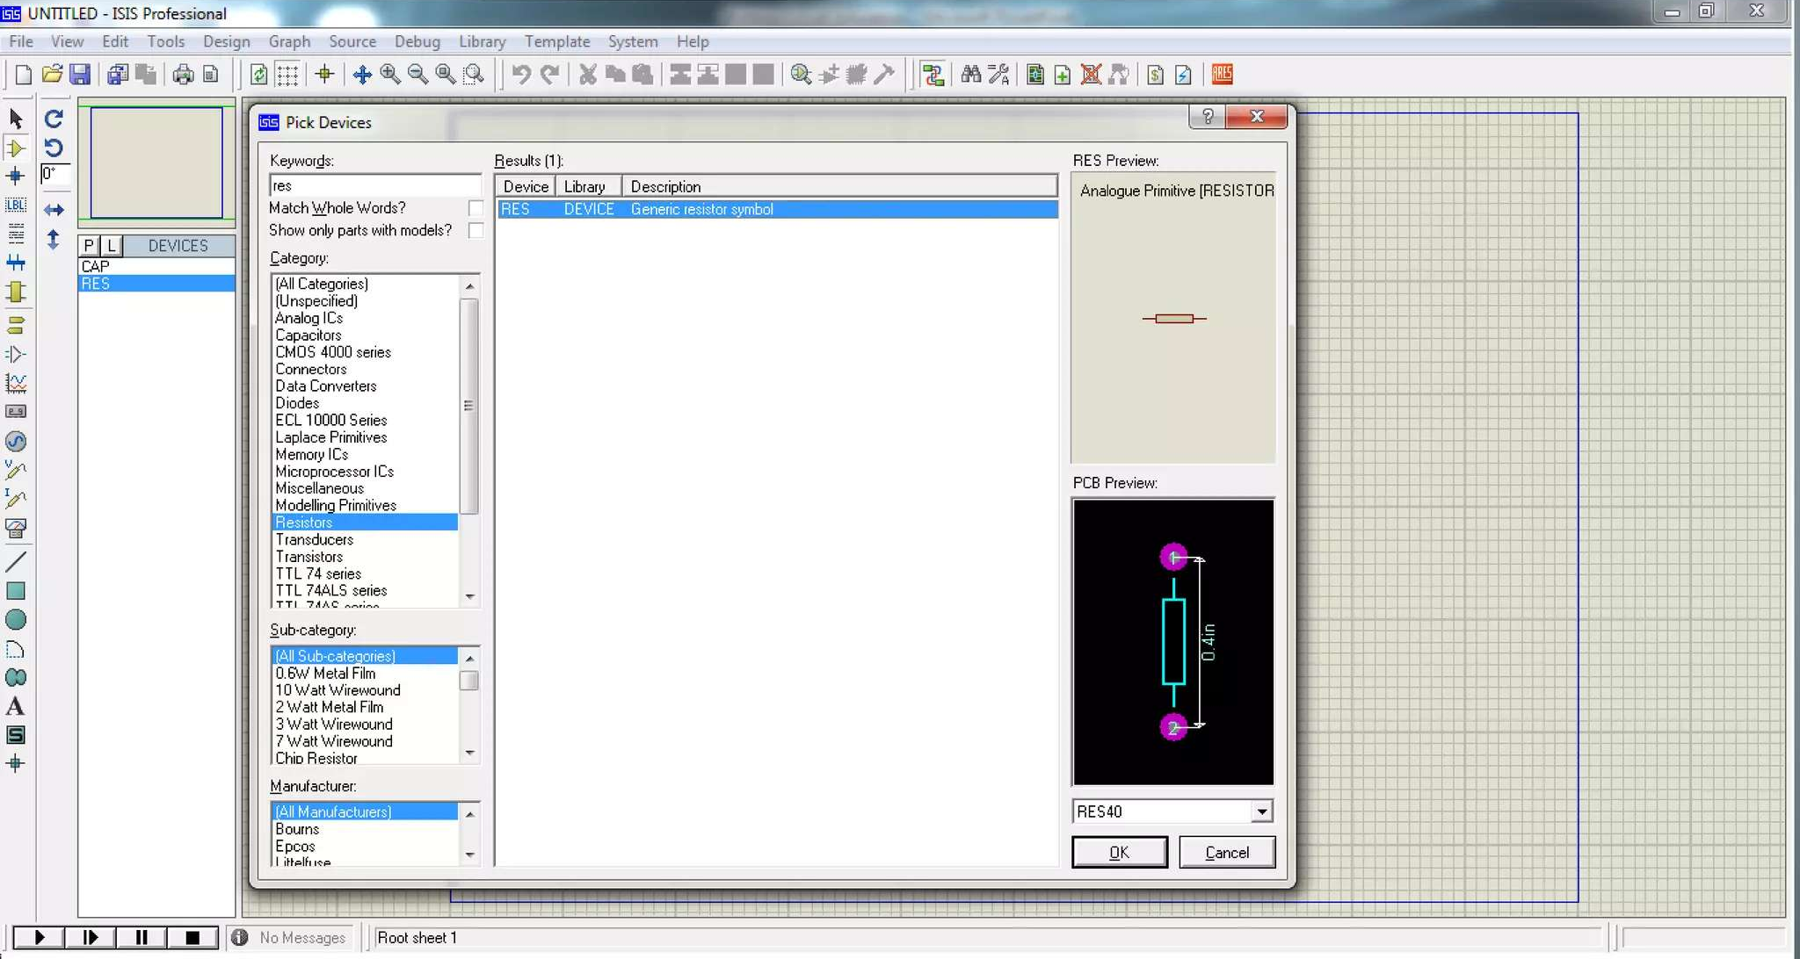
Place Components
Simply type the component name in ‘Keywords’ text box and the select the category for the desire component.

Slide 23
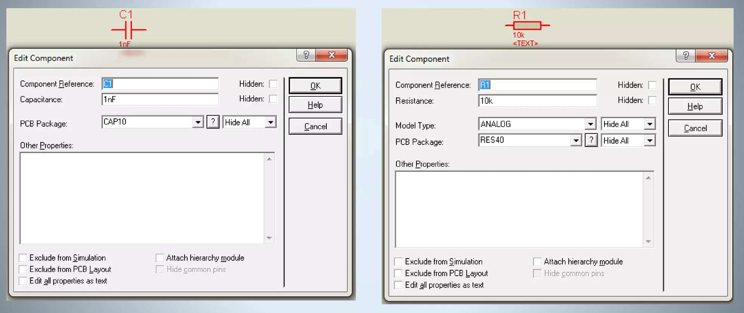
Edit Component Property

Slide 24
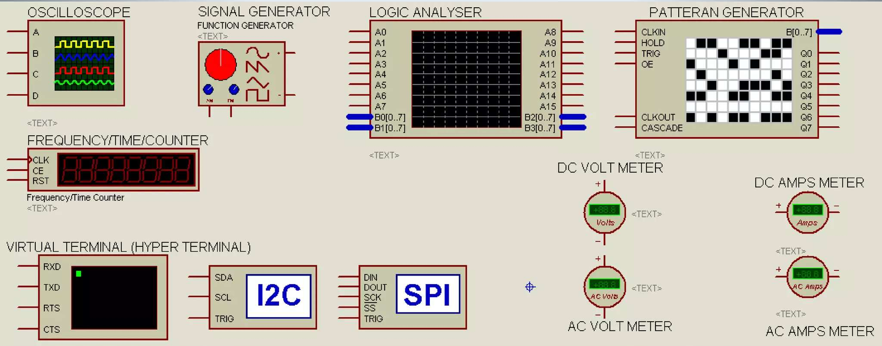
Instrument Mode

Slide 25
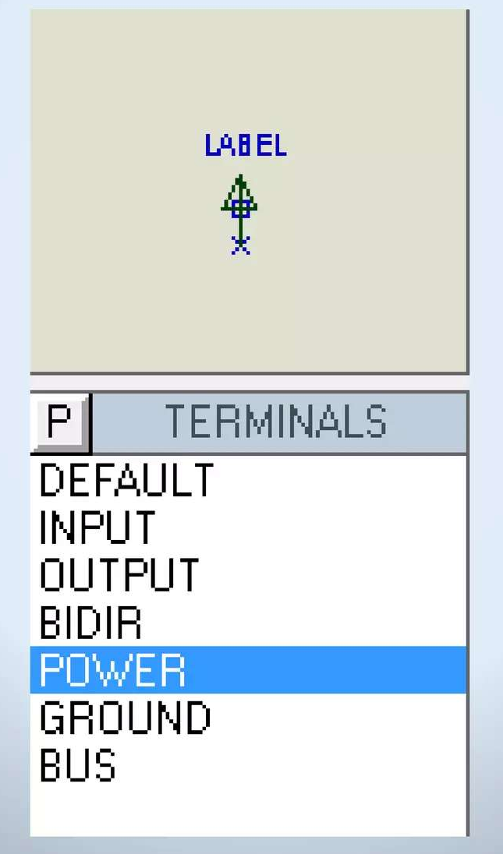
Terminal Mode

Slide 26
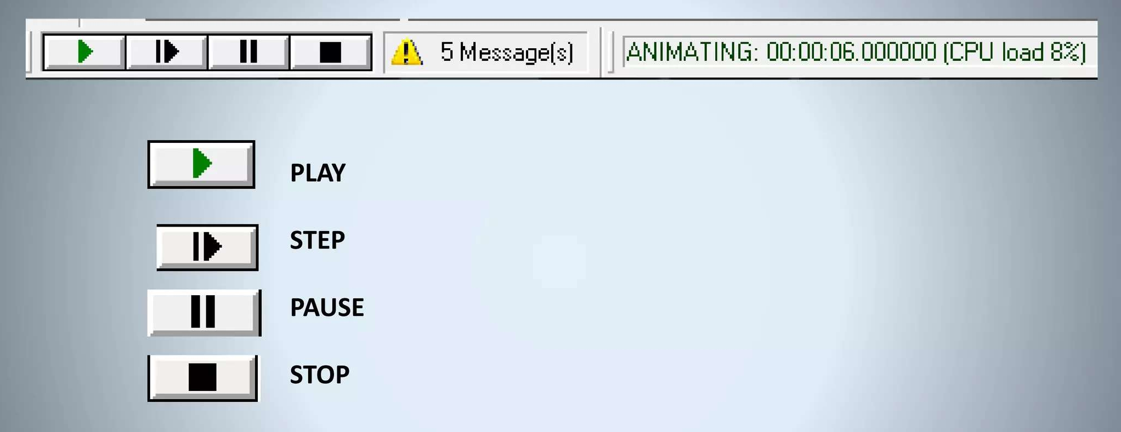
Simulation Section

Slide 27
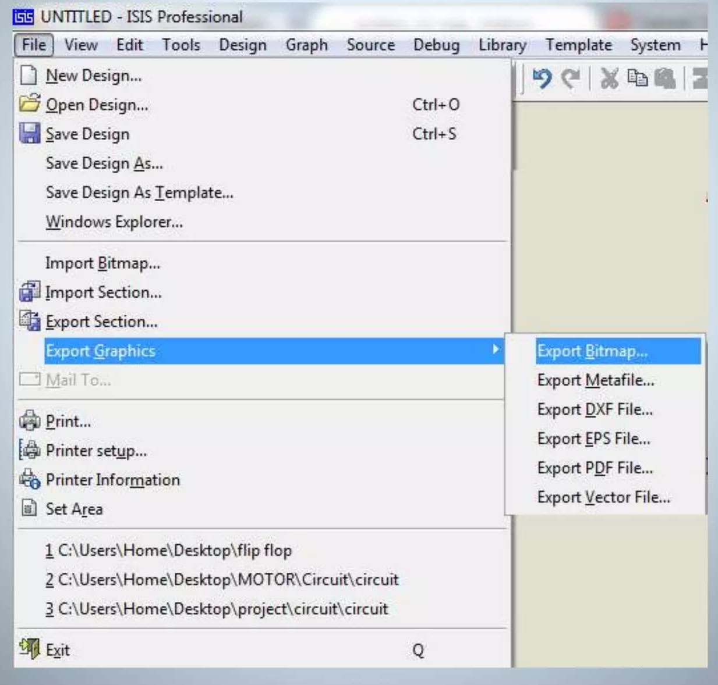
Save Schematic Diagram

Slide 28
Study simple component of Proteus and create a report about basic tools of Proteus

